Slide 1

Child and Maternal Mortality
Do you really care about your child and maternal health?
Then, how do you prevent those health problems?

Slide 2
Cardiotocograms (CTGs)
A technique of measuring fetal well-being
Simple
Cost accessible

Slide 3
How does it work?
The equipment itself works by sending ultrasound pulses and reading
its response, thus shedding light on fetal heart rate (FHR), fetal
movements, uterine contractions and more.

Slide 4
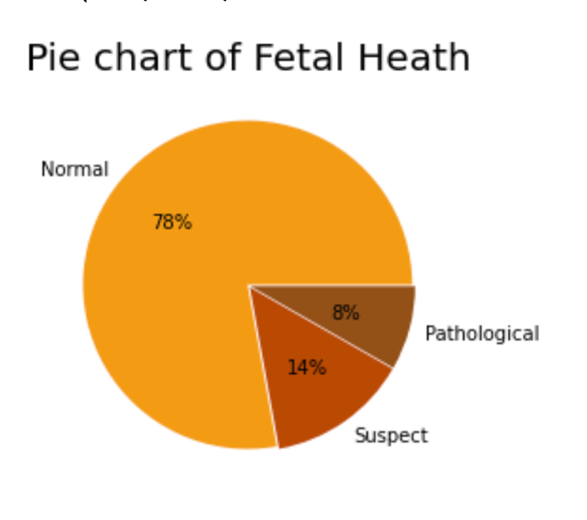
Data
The dataset contains 2126 records of features extracted from Cardiotocogram exams, which were then classified by expert obstetrician into 3 classes:
Normal
Suspect
Pathological

Slide 5
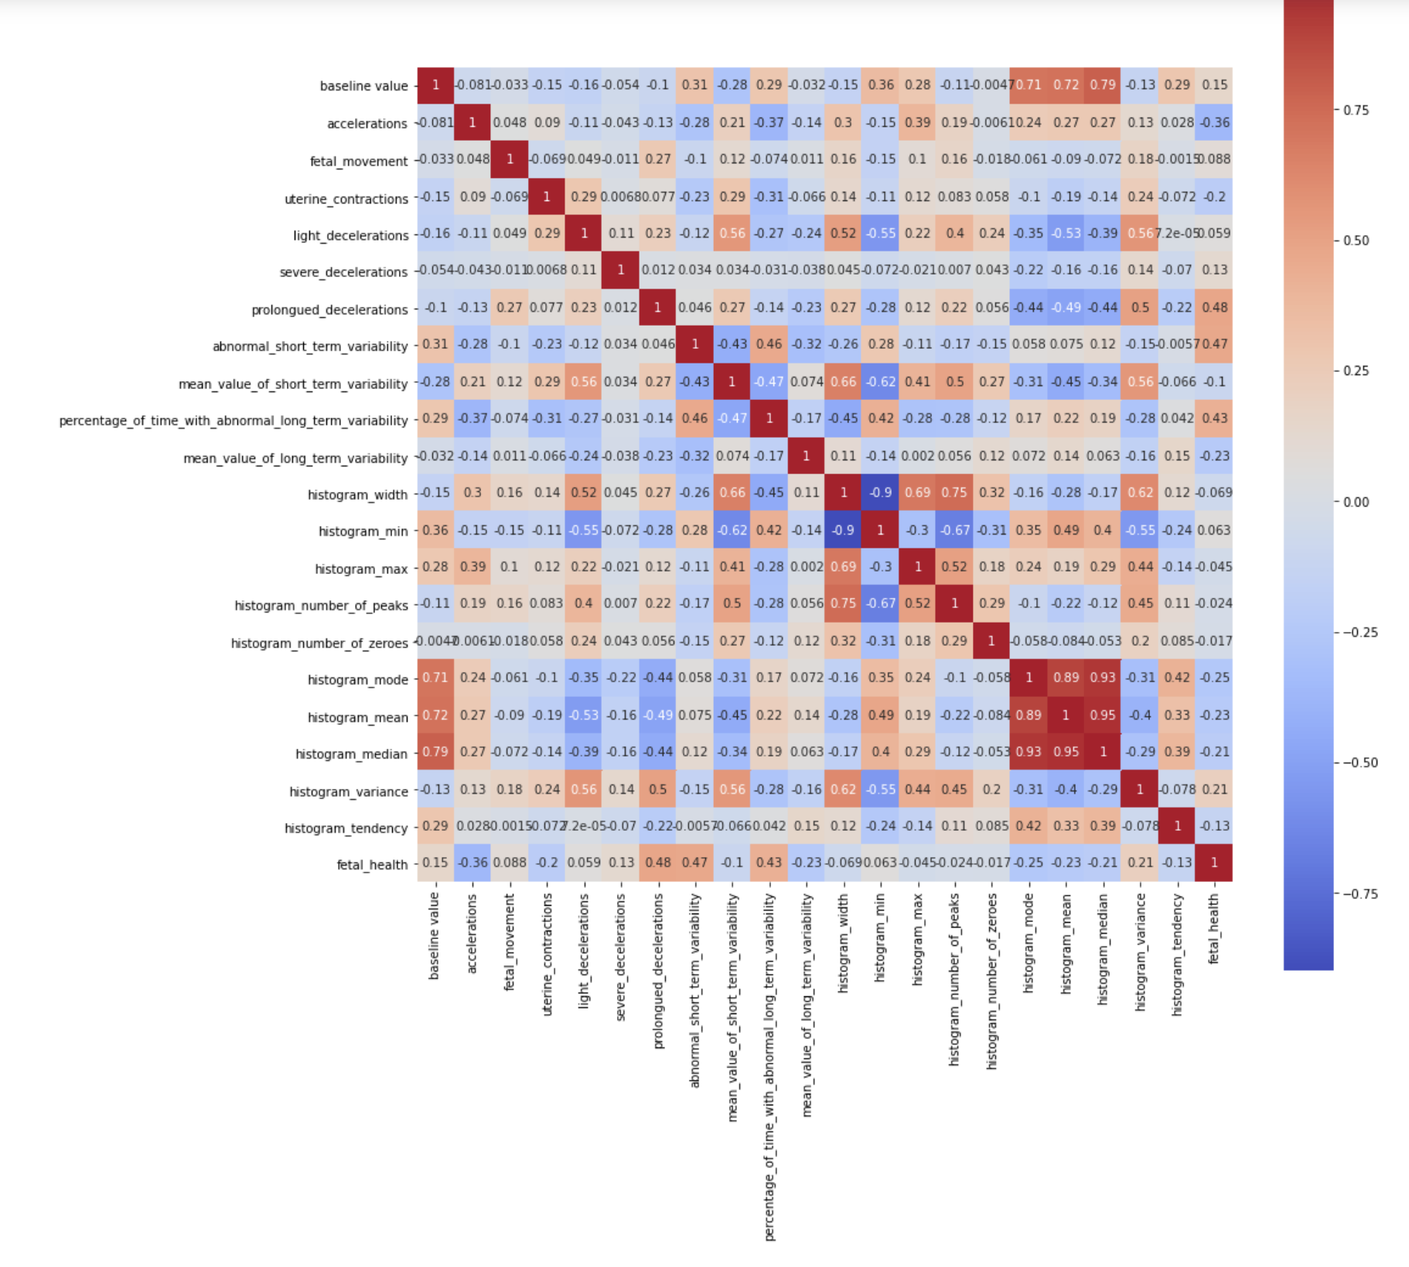
How other features correlate with fetal health?
Based on the correlation matrix, it is clear that:
"prolongued_decelerations",
"abnormal_short_term_variability",
"percentage_of_time_with_abnormal_long_term_variability"
are the features with higher correlation with fetal_health.

Slide 6
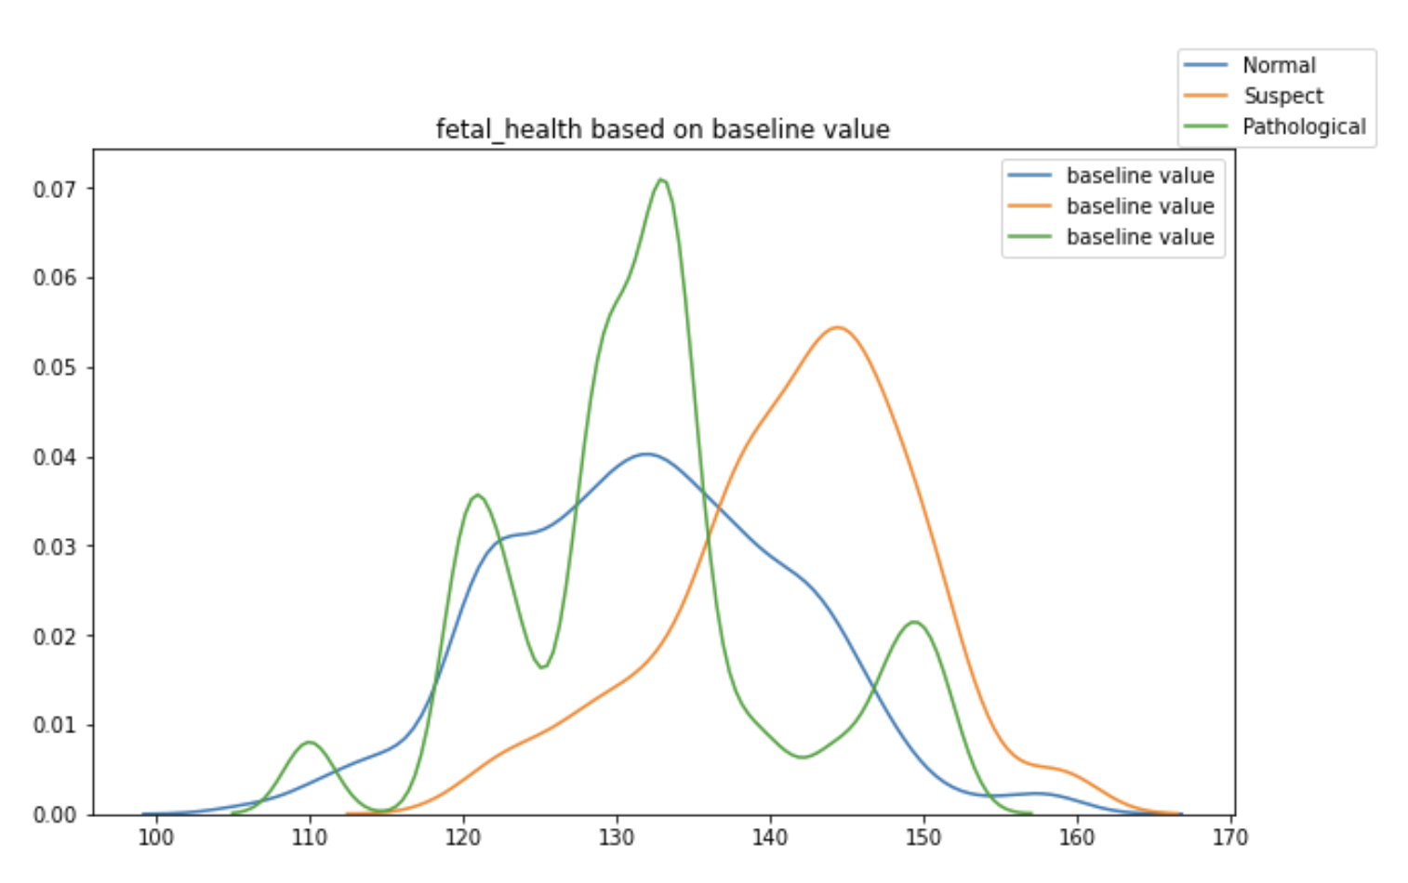
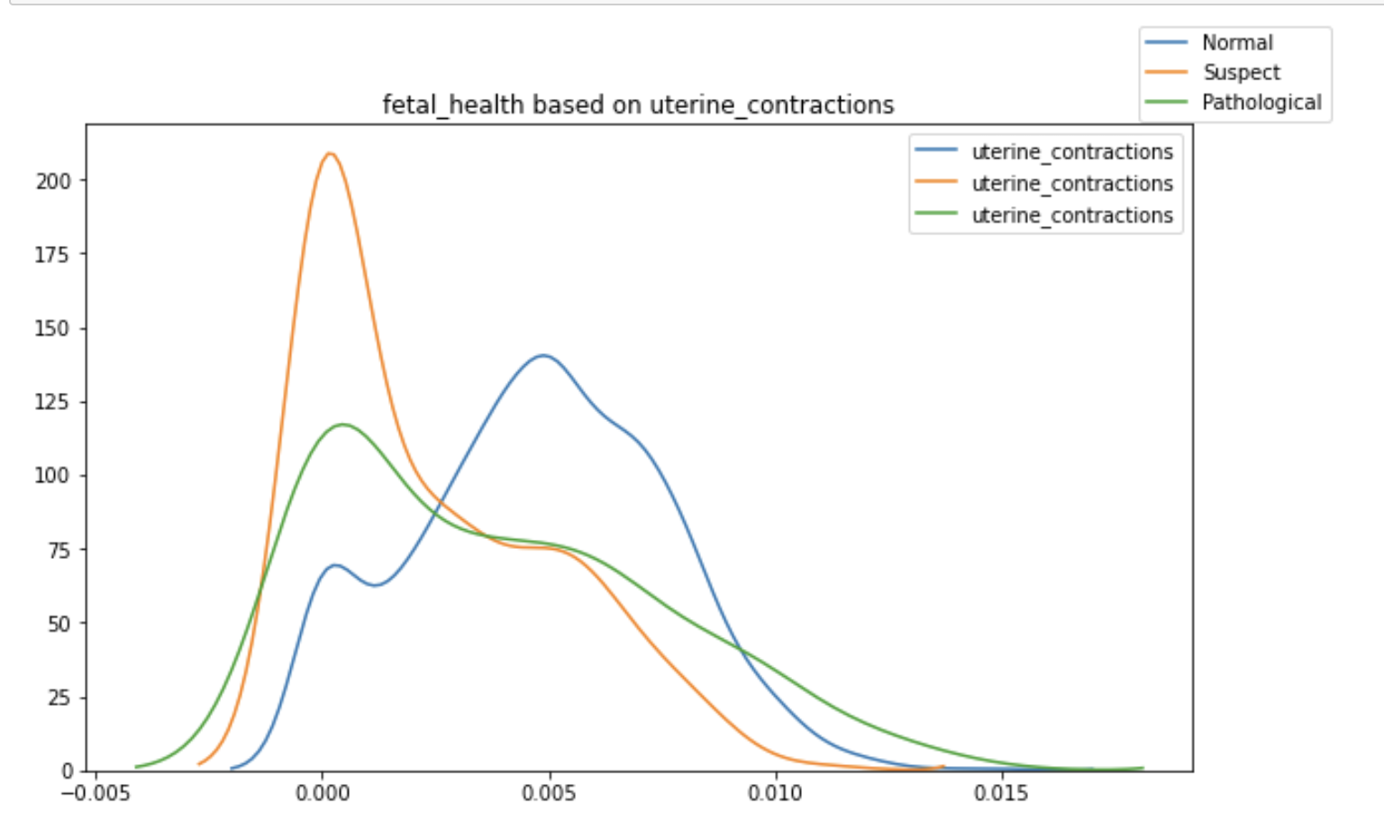
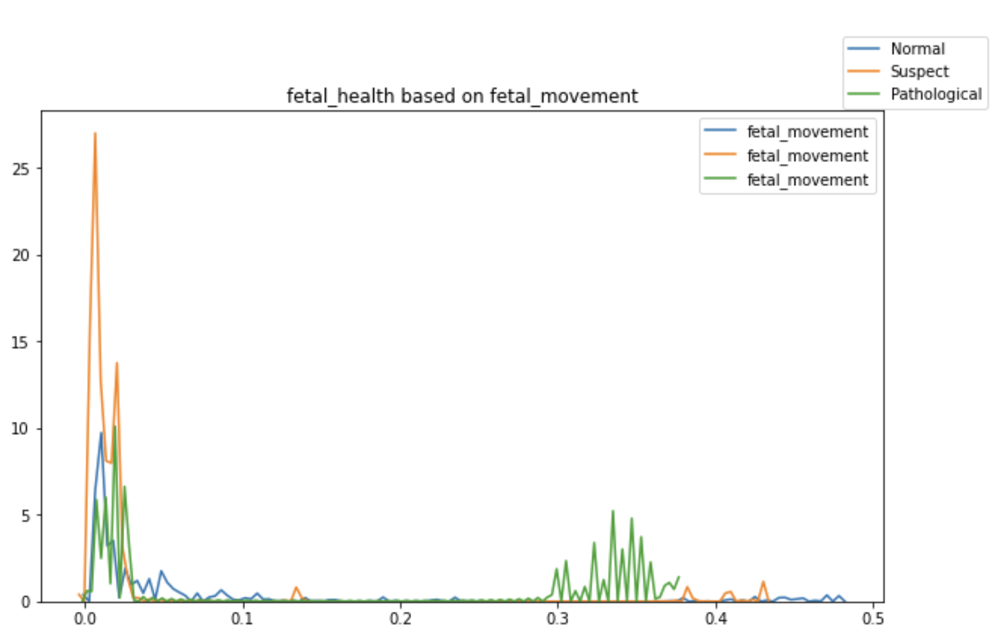
Correlations
As we see above:
Normal when uterine_contractions is > 0.0025 and Suspect when uterine_contractions is < 0.0025
Pathological when baseline value is between 125-135 and Suspect when baseline value is 135+
Suspect when fetal_movement is < 0.03 and Pathological when fetal_movement is between 0.3-0.38

Slide 7
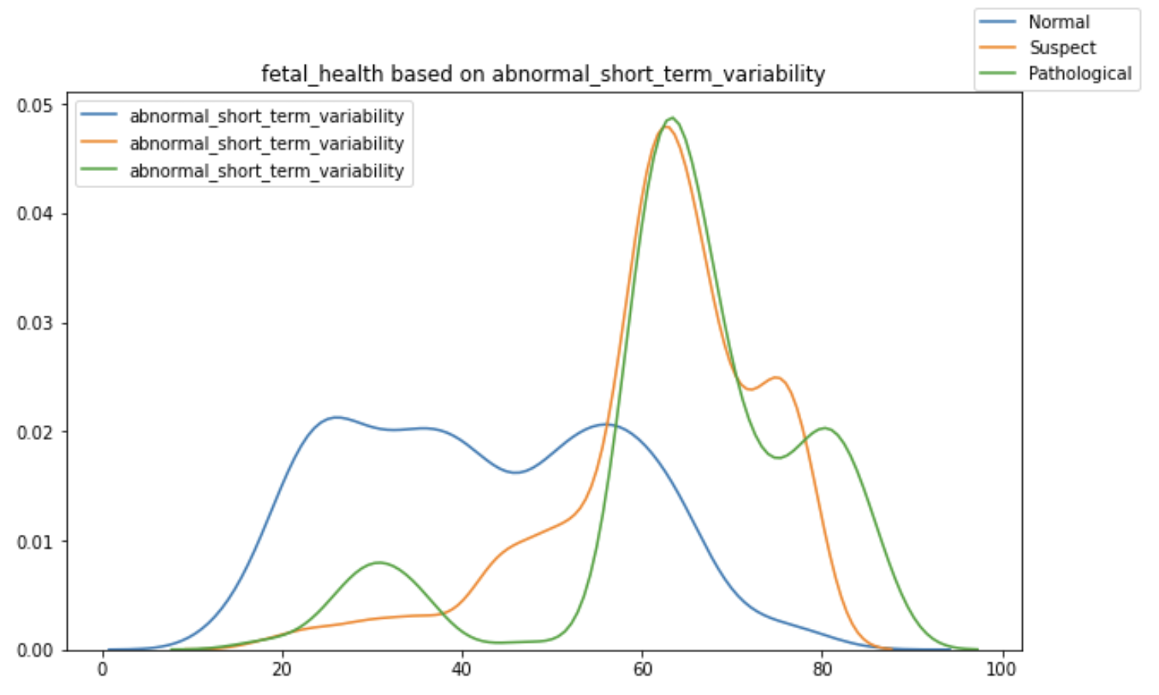
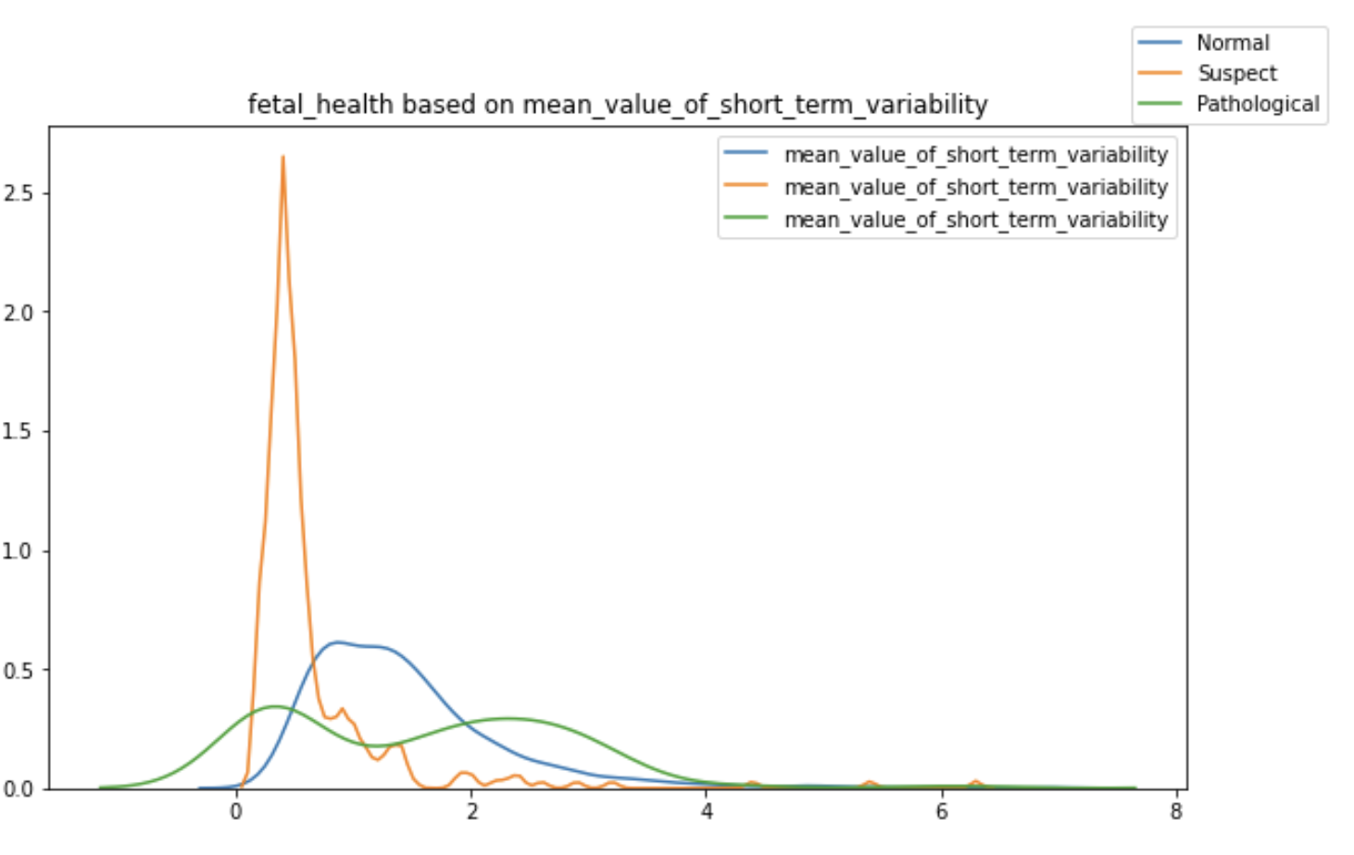
Correlations
As we see above:
Normal when abnormal_short_term_variability is <50
Suspect when mean_value_of_short_term_variability <0.8, Normal is 0.8-2, Pathological is >2

Slide 8
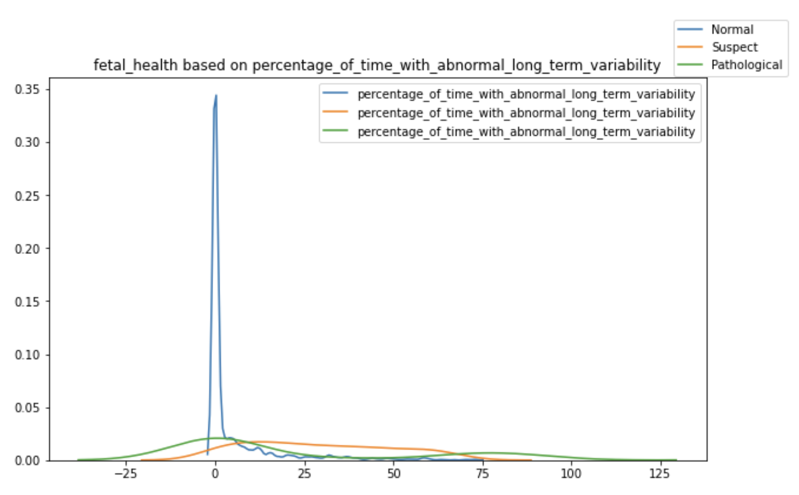
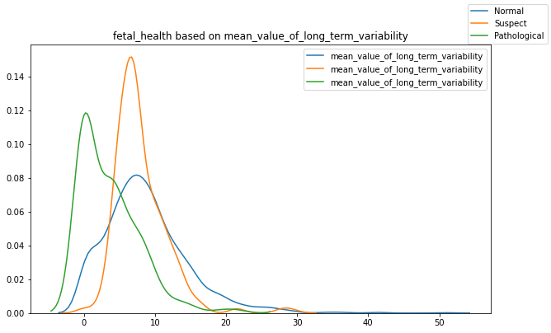
Correlations
As we see above:
Normal when percentage_of_time_with_abnormal_long_term_variability between (-8)-8, Suspect is 8-68 and Pathological is <-8 & >68
Pathological when mean_value_of_long_term_variability <3 , Suspect is 3-10 and Normal is 10+

Slide 9
Modeling
Create a 70/30 Train and Test split on data
Linear Regression
Fit Random Forest Classifier
Gradient Boosting

Slide 10
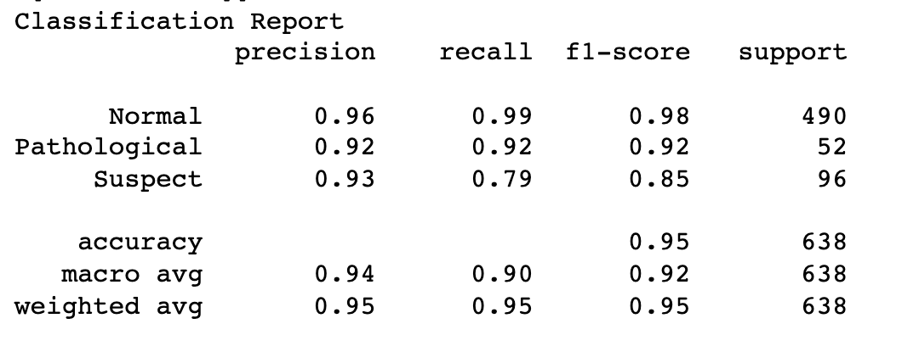
Predictions
Gradient Boosting model gives us the most accuracy with 95%.

